Slide 1
Inventory Managed System
Mohammed Ahmed
COHORT: 22EnableJune4

Slide 2
Introduction
I have completed the 5 week project which has been set out by QA academy as part of their 12 weeks course as an Software Engineer. During the project I have demonstrated and illustrated my understanding on what I have learnt since starting the course. During this project I have managed to understand areas in which I require further development as the project in itself I did not find difficult rather the testing area and the bugs which came with it.
I have used the following during my project:
MySQL - Relational database Management System
Java - Programming language
Maven - Built automation tool used in Java projects
Git Hub - Development platform where you can host, review codes, manage projects and build softwares.
Jira - Project management tool. Used to manage project which you work on
Eclipse - Integrated development environment. Used for programme in Java.
My thoughts on the project:
I had a structured plan and it initially it had gone well other than underestimating the Testing section and an issue which I had encountered when trying to add an item to orders, calculating the cost for an order and deleting an item in an order. Although I had a solid plan the execution was not fulfilled as I had ran into coding errors and tried my absolute best to resolve.
I had broken down my days into sections in which I would ensure I had achieved every task outlined for that day. E.g. all the Jira tasks which needed to be done, along with the database in MySQL had to be connected to Eclipse, Risk assessment was all done on Day 1. Which would leave day 2 & 3 to be done on the coding issues and day 4 & 5 to be the Testing days. However I was not able to stick to the plan due to encountering issues on the order section which had taken almost 20 hours.

Slide 3
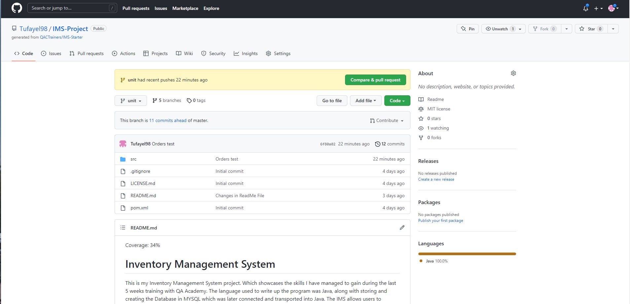
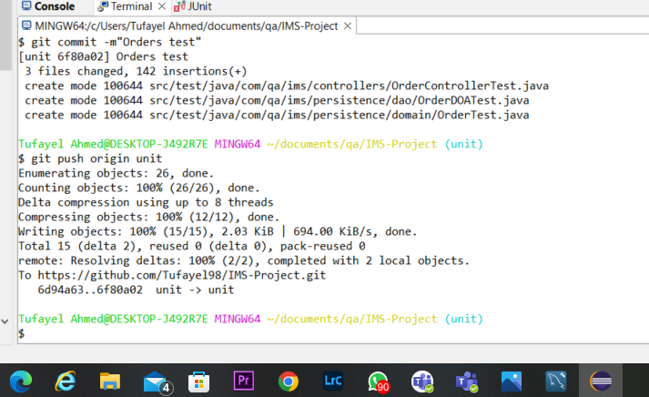
Integration
Throughout the project, I had tried to continuously make commits and updates to any changes which I was making. I had made separate branches to work from as per each task which I was doing in order to separate the branches and ensure any updates and changes are done smoothly.
I have not yet merged all the branches together into the main branch, but this will be done before end of day today.

Slide 4
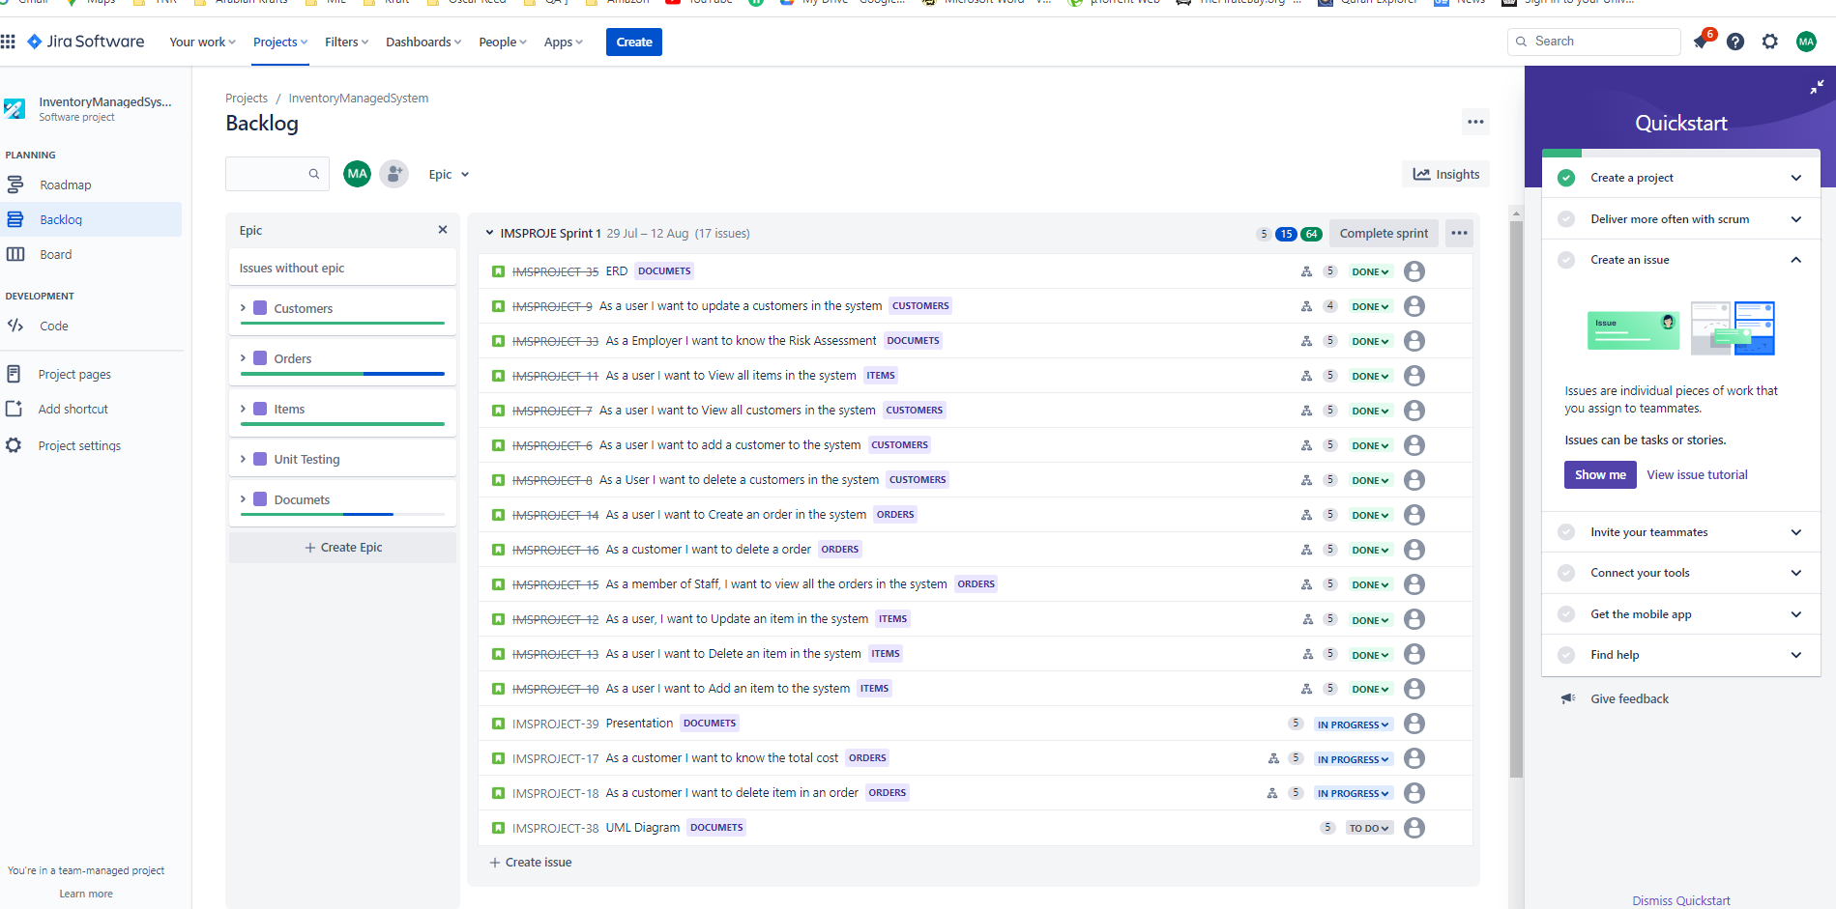
Jira
I managed to connect the jira software into Java so whilst I had been completing each user story it would be getting updated.

Slide 5
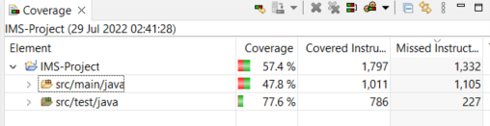
Testing
I tested all my codes which where in the src/main/java folder.
I had aimed to get the industry average of 80% coverage , however my overall just came below 60%.

Slide 6
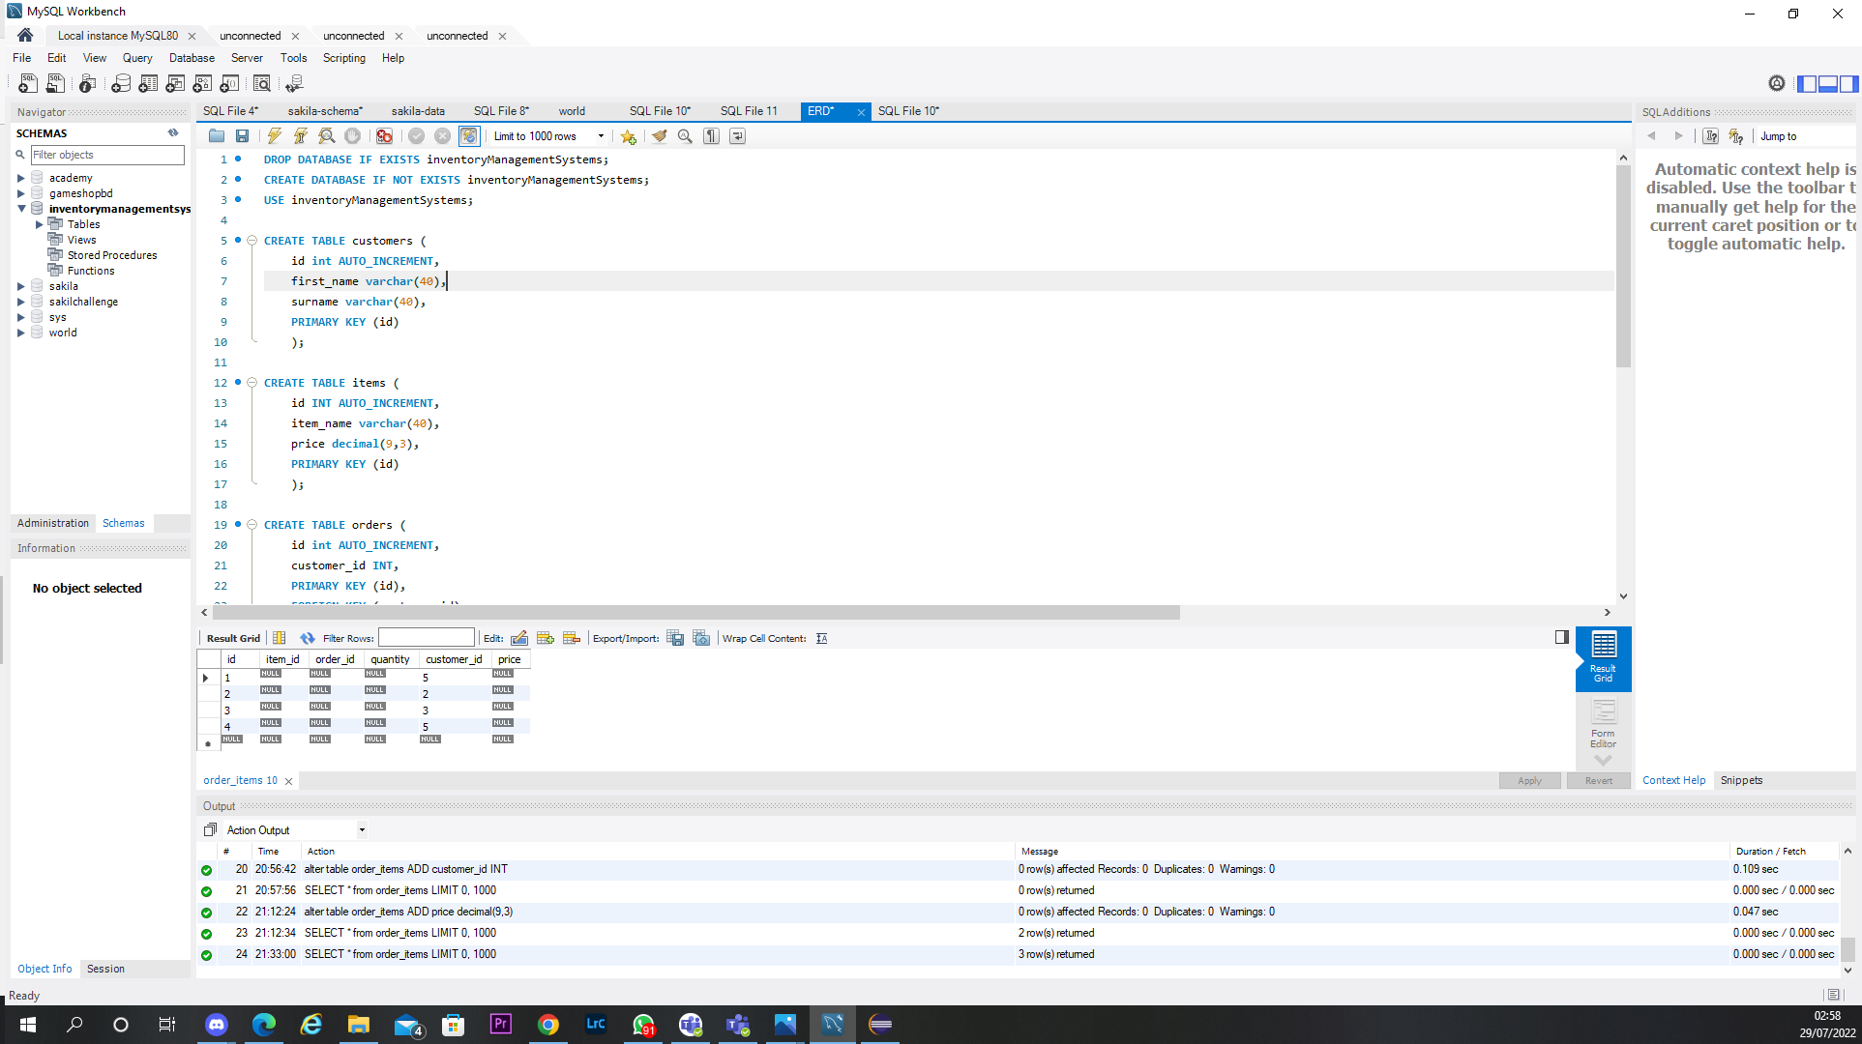
MySQL
I had integrated MySQL with my project through the sql-data and sql-schema files.

Slide 7
Sprint Review
Pro’s:
Managed to input all the user stories from the specification
Managed to make an application which has the CRUD features
Managed to add 3 classes, customers, items and orders
Managed to make the application interact with the end user via the command line interface
Managed to do the J-unit testing
Managed to connect the database of the sequel into the Java project
Managed to make commits into the repo and make several branches
Managed to make the ERD diagram
Managed to make a Risk Assessment
Con’s:
Issues with adding an item to orders, calculating the cost for an order and deleting an item in an order
Issues with testing in general

Slide 8
Sprint Retrospective
What went well:
Creating the item classes was simple and easy to comprehend once you look at the code which was given and understand each package and what the requirements are.
Implement the CRUD functions
Improvement
Try setting a fixed time on certain things and then coming back to them. I had taken too long trying to fix certain bugs which I could have came back to which wouldn't have caused me to loose time.
Go over testing more, understand it further, improve my knowledge in it and go through examples and break things down for me to understand it.

Slide 9
System.out.println
(“Thank you for your time !”);
:) :) :)

